Slide 1
BOSTON UNIVERSITY Senior Research Assistant and Programmer Search February 2022
Candidate Name: Shuang Song

Slide 2
AAU Doctoral Exit Survey – DEI Analysis
With the AAU, we seek to better understand the experience of our PhD students
Hope to use survey results to improve PhD student experience at University A.
Since its inception, the Doctoral Exit Survey has achieved close to a 90% response rate
The DEI Analysis includes data from January 2019-September 2021
For the purposes of the DEI analysis, respondents were classified as “Underrepresented” or “Non-Underrepresented” by their responses to the race/ethnicity questions in the survey

Slide 3
The Term ‘Under-Represented Group’
In this presentation and analysis, the term ‘Under-Represented Group’ pertains to those student respondents who have self-identified as ‘American Indian or Alaska Native,’ ‘Black or African American,’ ‘Hispanic or Latino,’ and ‘Native Hawaiian or Other Pacific Islander.’ Students who identified as ‘Two or More Races’, that included at least one of the categories listed above, were also classified as “Underrepresented.”
These students are aggregated together because their low representation in the dataset would make it difficult to draw comparisons and important conclusions that might influence future policies and programs relevant to UA’s efforts in promoting and sustaining Diversity, Equity, and Inclusion.
Due to a recent change in UA’s current internal policy (which is still under formulation), we have been advised by AS&IR to no longer use the term ‘Under-Represented Group’ until further resolution.
Since this presentation was prepared prior to this advisement, we have retained the usage of this term. As soon as a decision is made on final terminology and definitions, we will update our presentations, as appropriate.

Slide 4
Under-Represented Students
Students who are classified as “Under-Represented” in this analysis include:
African American/Black Students
Hispanic/Latino Students
American Indian or Alaskan Native Students
Native Hawaiian or Pacific Islander Students
NOTE: Students who identified as two or more races, including at least one of the categories listed above, were also classified as “Underrepresented.” International students were excluded from the analysis.
Notes:
Two or More Races category includes:
Three students who identify as both black and white
One student who identifies as both NHPI and white
One student who identifies as both AIAN and white
One student who identifies as Asian, NHPI, and White
One student who identifies as AIAN, Asian, and White

Slide 5
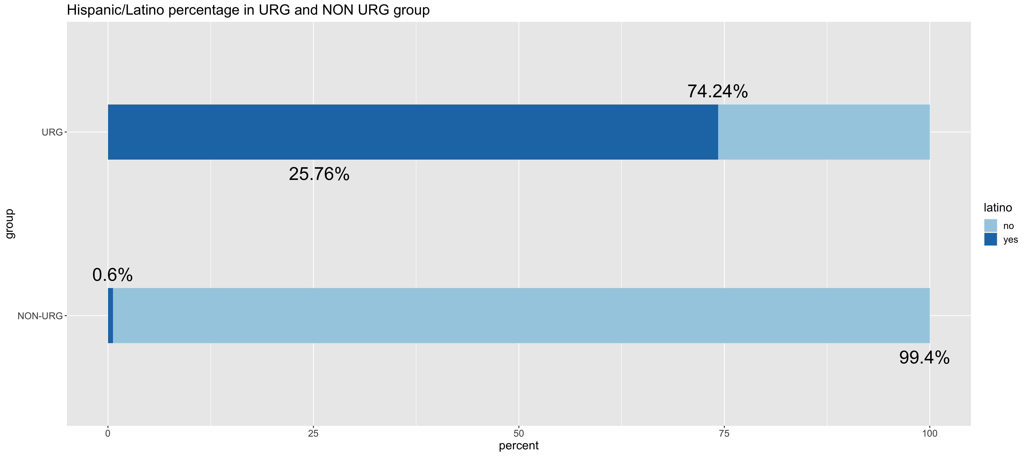
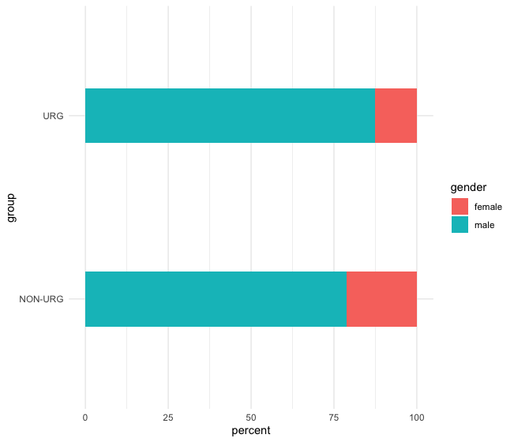
Data Highlights

Slide 6
Data Highlights - II

Slide 7
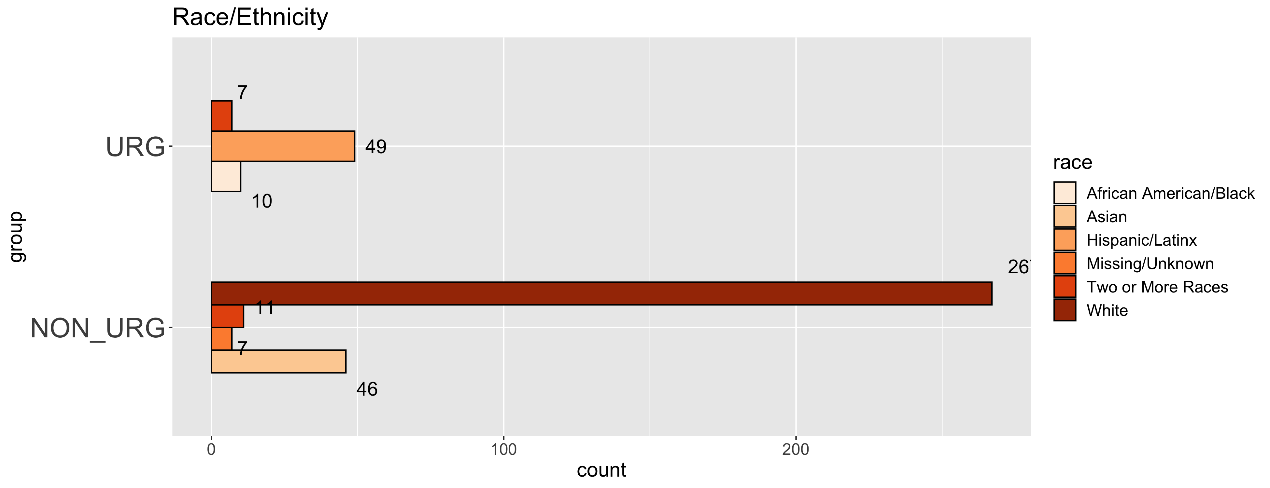
Data Highlights - III

Slide 8
Faculty Interactions

Slide 9
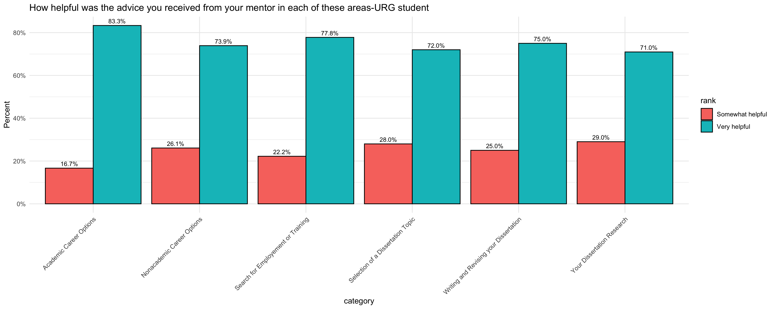
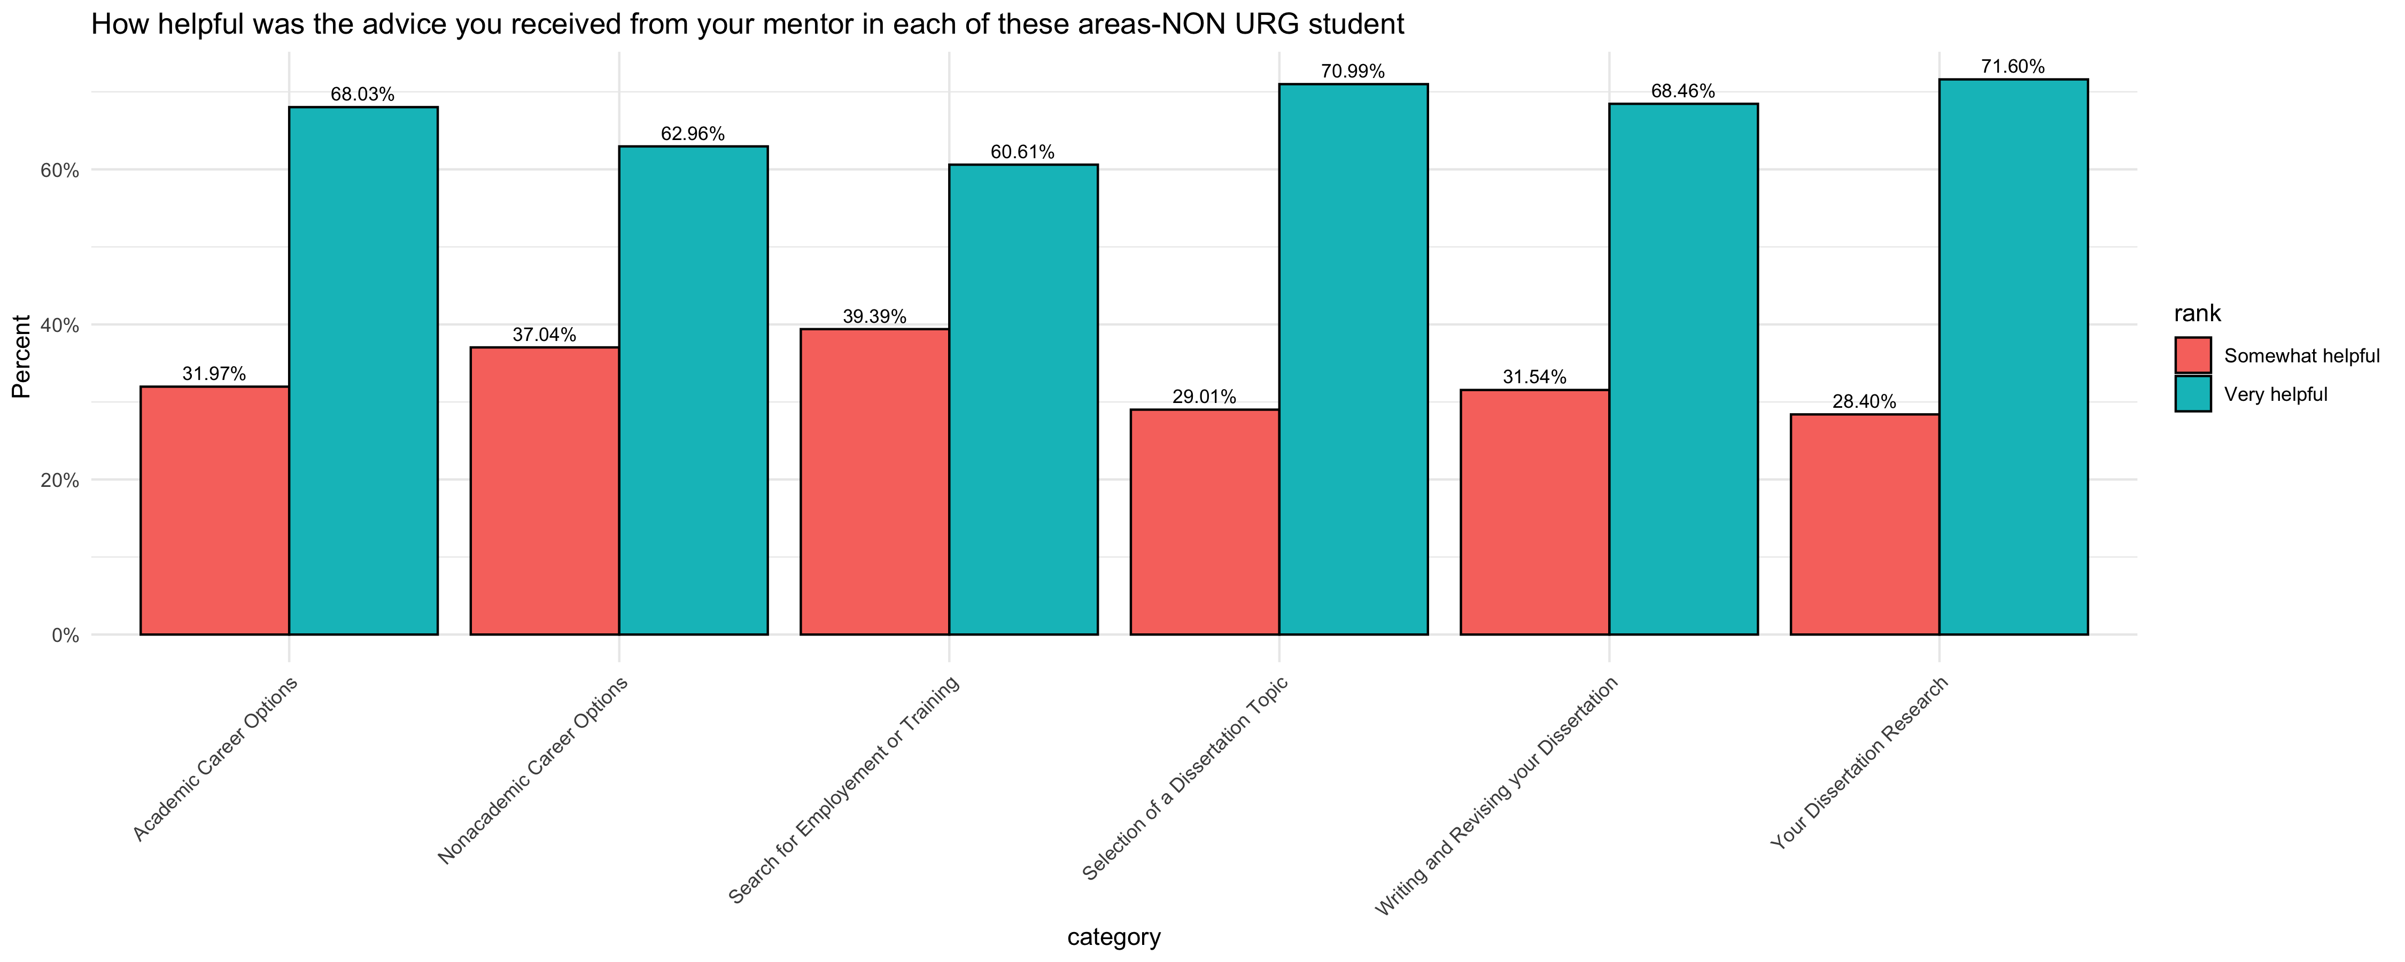
Faculty Interactions
In comparison to their non-URG counterparts:

Slide 10
Faculty Interactions
There is no significant statistical difference between URG and non-URG students for these categories.

Slide 11
Faculty Interactions
There is no significant statistical difference between URG and non-URG students for these categories.

Slide 12
Social Experiences
URG Students are more likely to feel respected by their peers are less likely to feel included and accepted in comparison to their Non-URG counterparts.
1=Strongly Disagree, 2=Disagree, 3=Ambivalent, 4=Agree, 5=Strongly Agree
There is no significant statistical difference between URG and non-URG students for these categories.

Slide 13
Overall Satisfaction

Slide 14
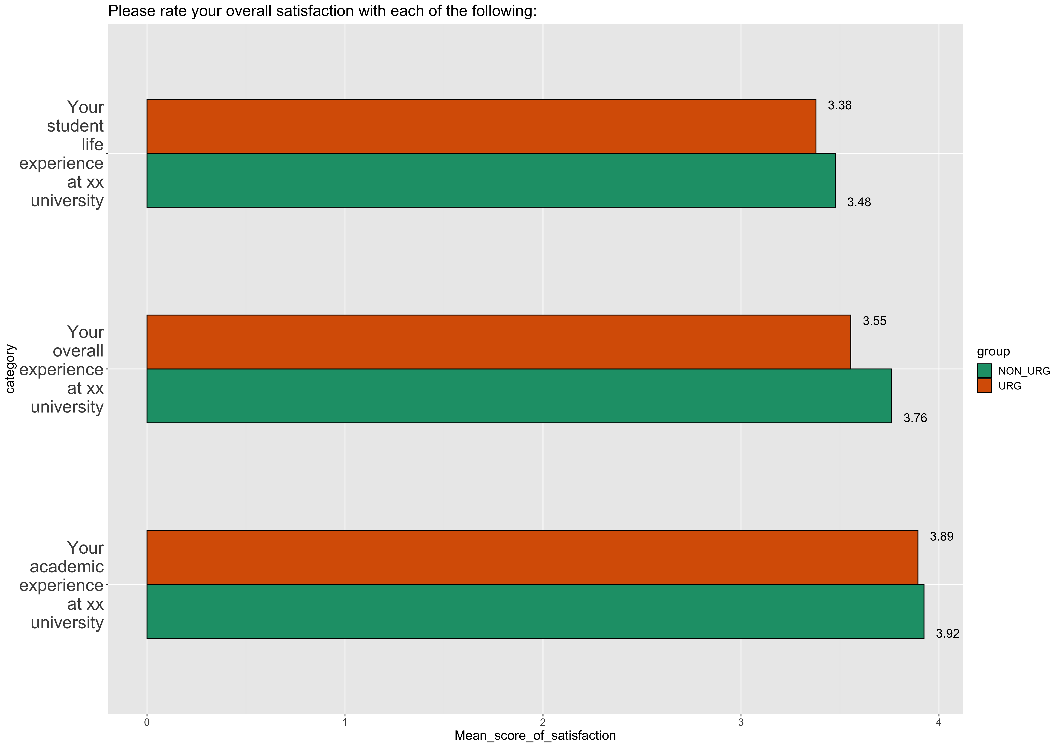
Overall satisfaction
In comparison to their non-URG counterparts:

Slide 15
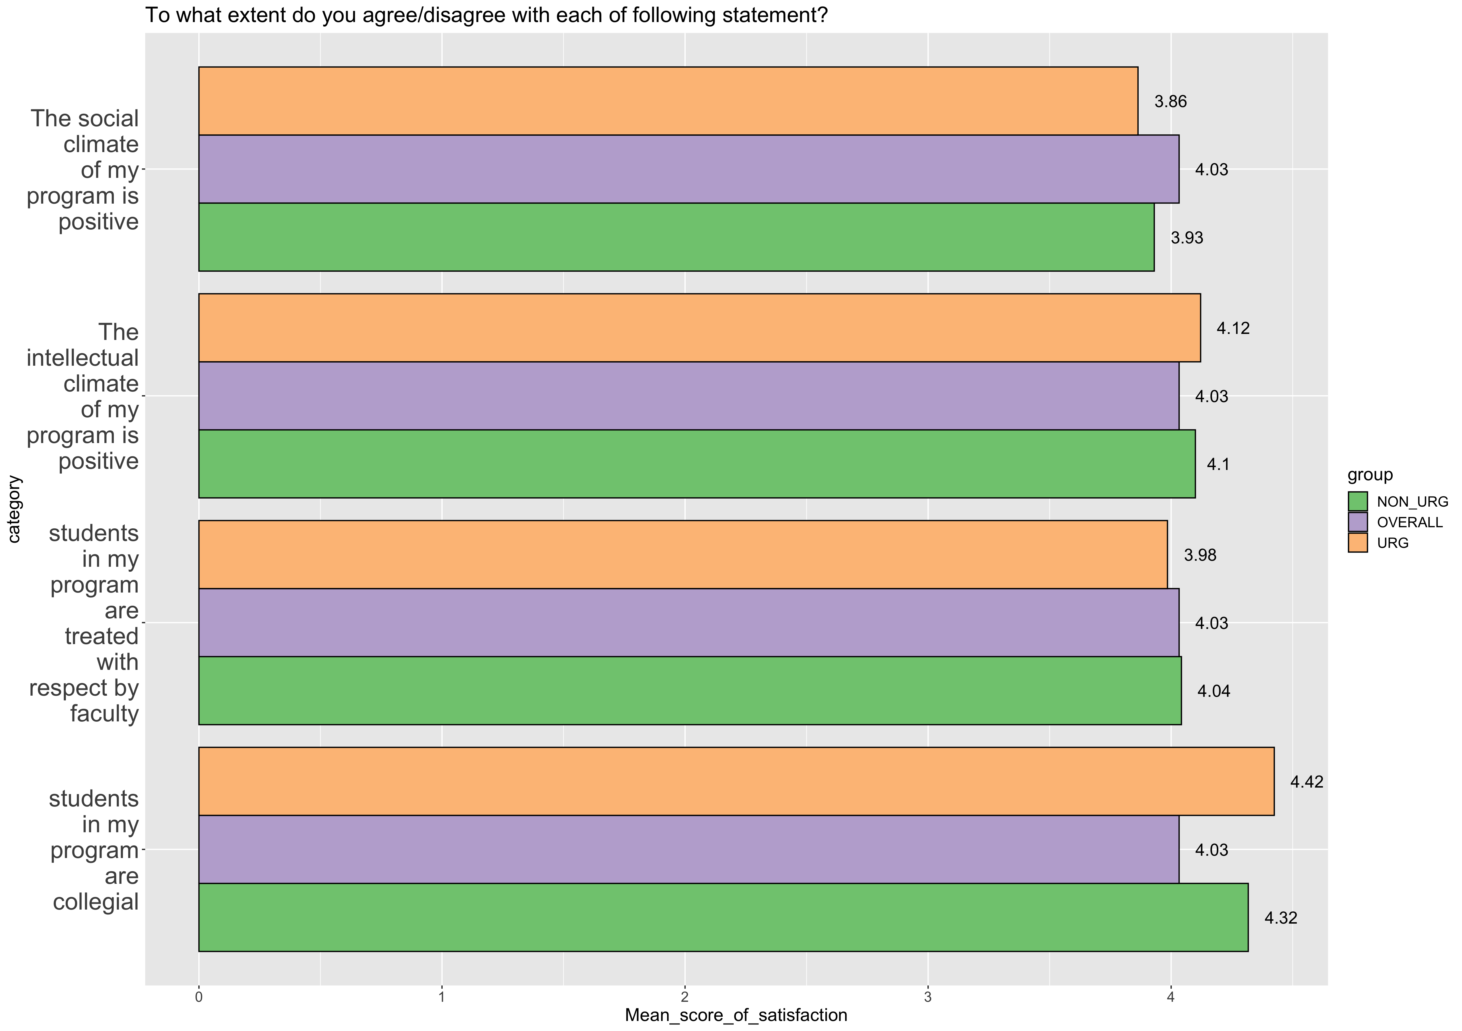
Overall Satisfaction
In comparison to their non-URG counterparts:

Slide 16
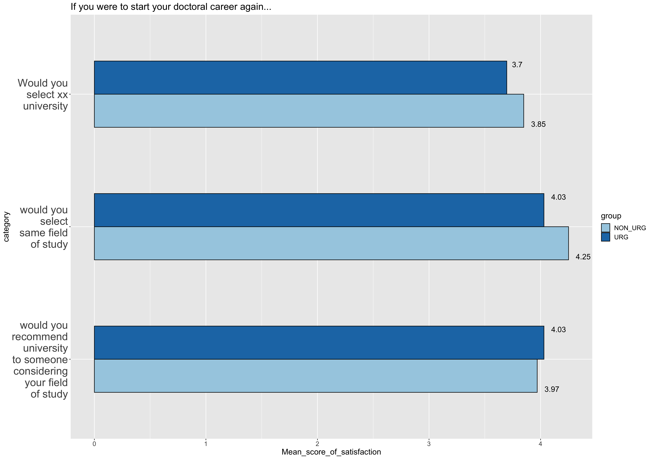
Overall Satisfaction
In comparison to their non-URG counterparts:

Slide 17
Faculty Mentoring and Advising

Slide 18
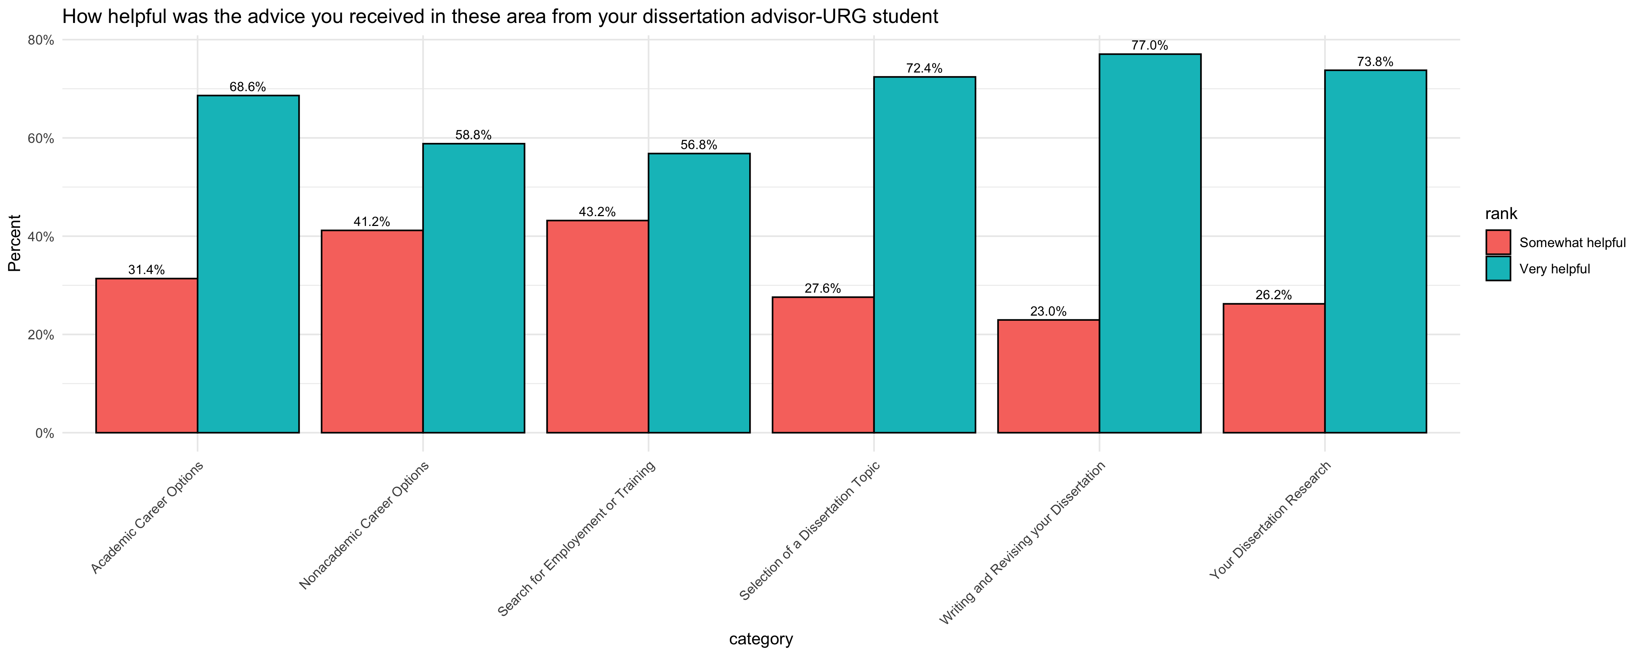
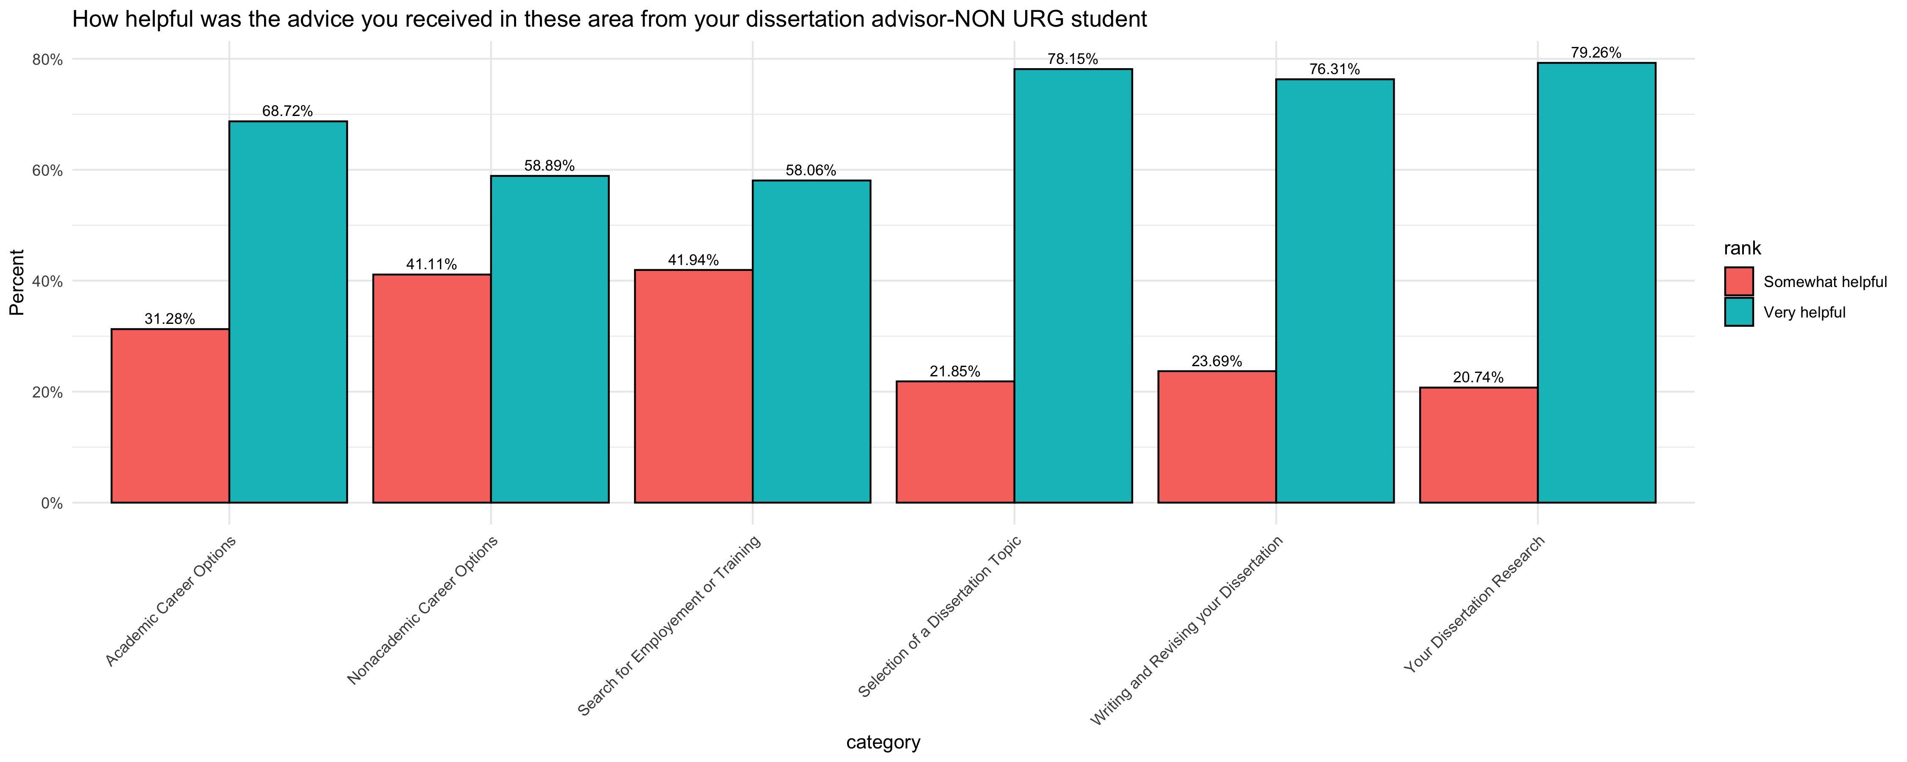
Faculty Mentoring and Advising
In comparison to their non-URG counterparts:

Slide 19
Faculty Mentoring and Advising
In comparison to their non-URG counterparts:

Slide 20
Conclusion

Slide 21
UA - AAU Doctoral Exit Survey Results Methodological Considerations/Technical Notes

Slide 22
UA - AAU Doctoral Exit Survey Results Methodological Considerations/Technical Notes

Slide 23
AAU Doctoral Exit Survey Results Methodological Considerations/Technical Notes

